Slide 1
Physical Security: How attackers gain physical access and what they can do in meatspace
CIS 5930 / 4930
Offensive Security
Spring 2013

Slide 2
Overview
Gaining Physical Access
Locks
Lockpicking
Below the OS layers & Inside the Mobo bus
Ethernet over Powerlines & Bypassing security systems
BacNET systems

Slide 3
Why Is Physical Security Important?
People do crazy things: http://www.dailymail.co.uk/news/article-2083556/Meet-girl-blogger-sneaked-inside-Russian-missile-factory--security.html

Slide 4
Credits
Many of these fantastic diagrams / animations are from The Open Organization Of Lockpickers (check them out!):
http://toool.us/

Slide 5
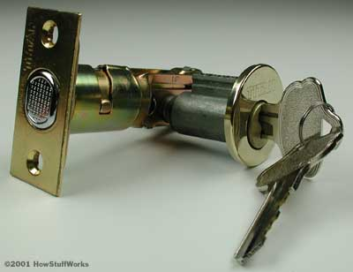
Lock + Bolt

Slide 6
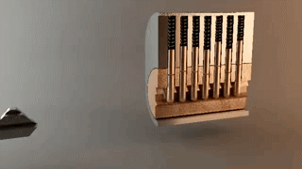
How locks work
http://i.imgur.com/ETTfE.gif
The Shell
The Plug
Key hole

Slide 7
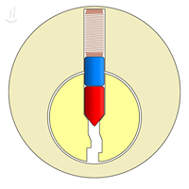
How locks work
Without a key, the lock wont turn
it will "BIND"

Slide 8
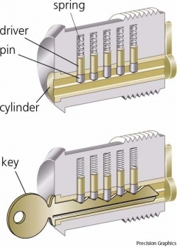
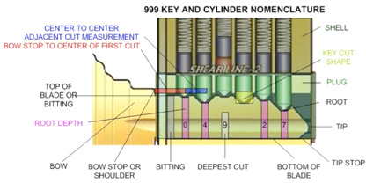
Lock terminology
Note: Drivers are usually also just called Pins
Cylinders are usually also called Plugs

Slide 9
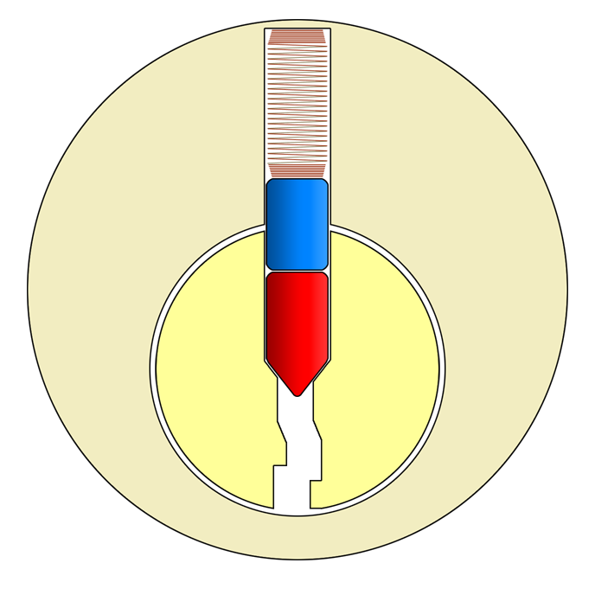
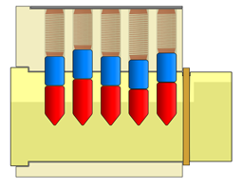
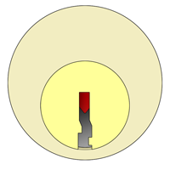
How locks work

Slide 10
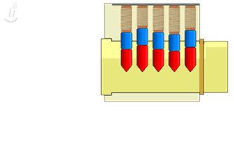
How locks work
The sheer line:
The area/separation between the plug and the shell
when the key fits, all the pins and drivers will separate perfectly at the sheer line
http://toool.us/deviant/index.html

Slide 11
How locks work
http://i.imgur.com/ETTfE.gif
If the pin and drivers aren't separated AT the sheer line, the lock wont turn
The lock will "BIND"
The Shell
The Plug

Slide 12
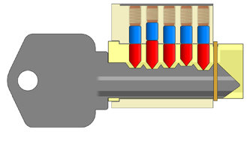
Bind on incorrect key

Slide 13
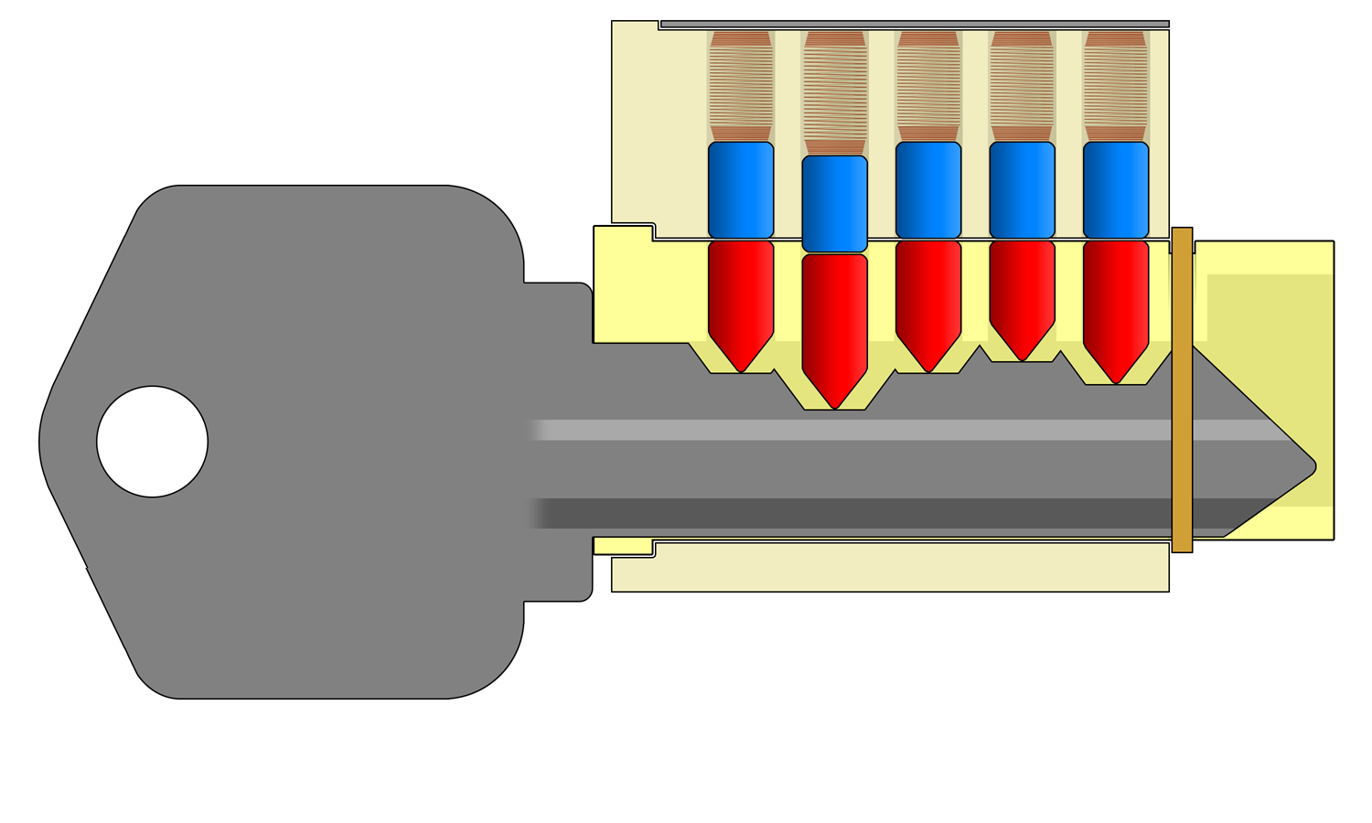
Bind on incorrect key

Slide 14

Intro to lockpicking
Imagine a one pin lock:

Slide 15
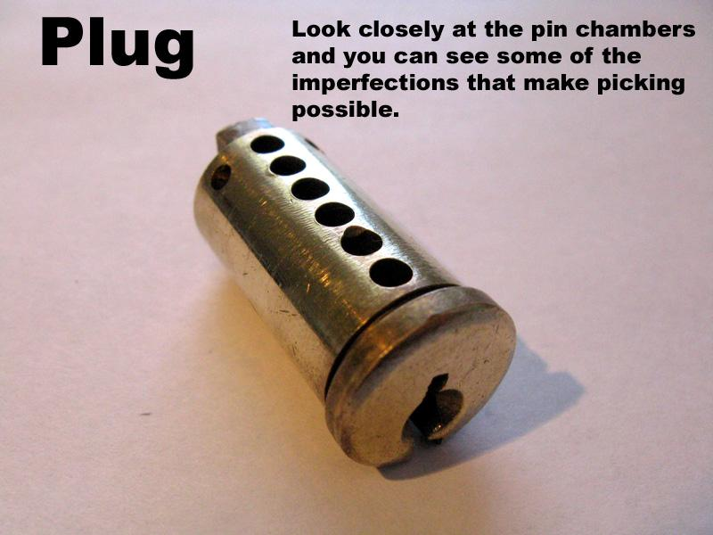

Slide 16
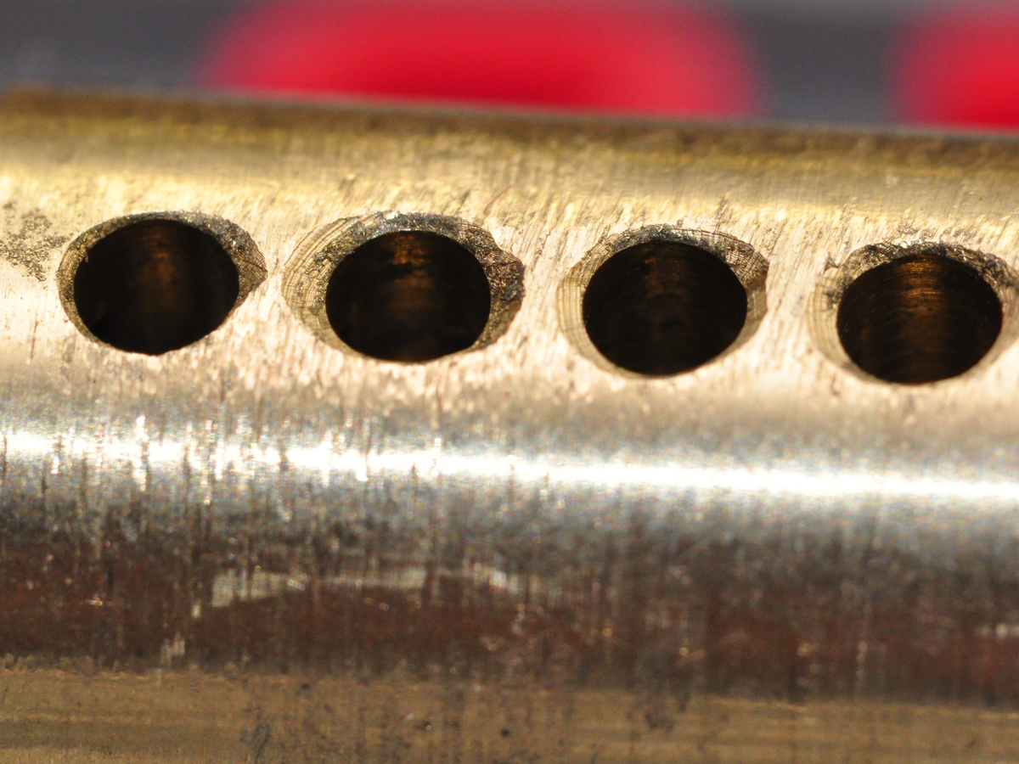

Slide 17
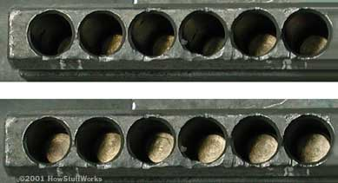
Plug Imperfections
b

Slide 18
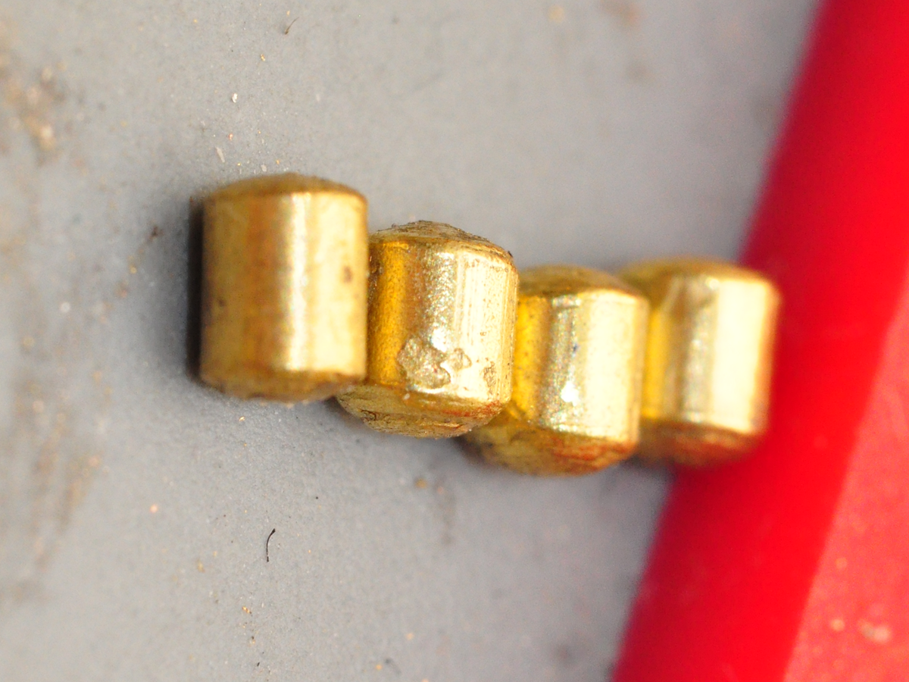

Slide 19
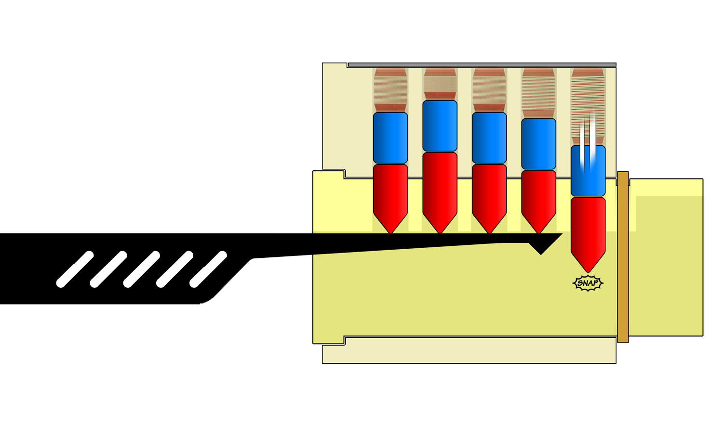
Counting Pins

Slide 20
Lockpicking
http://toool.us/deviant/02-picking/2.09-picking_by_individual_lifting.gif

Slide 21
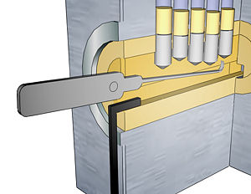
Lockpicking
Common mistakes:
TOO MUCH TENSION
Turning plug wrong way
being too forceful
be gentle!

Slide 22
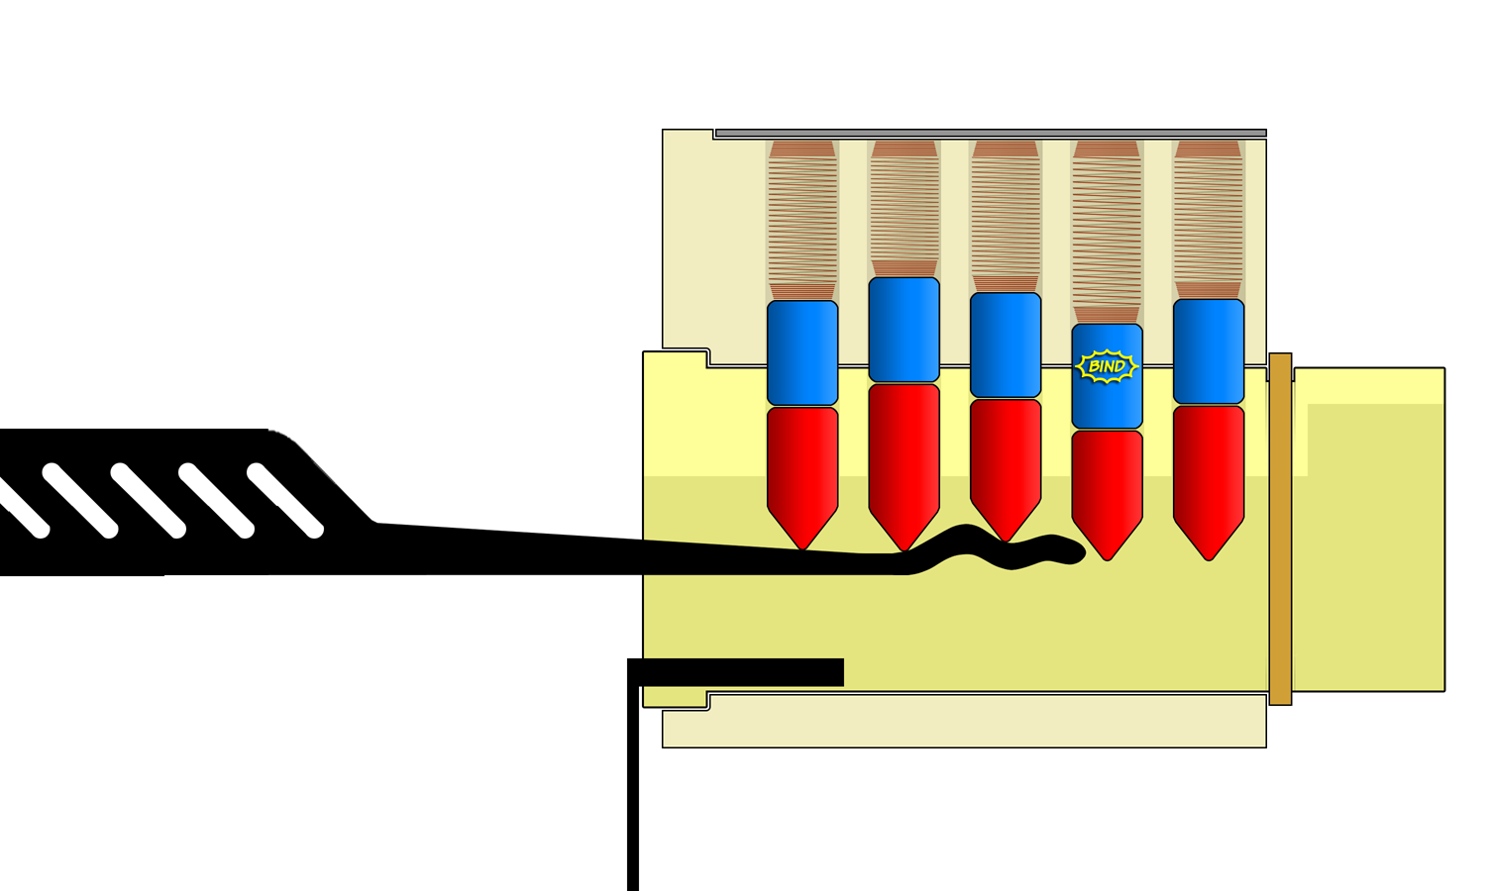
Raking

Slide 23
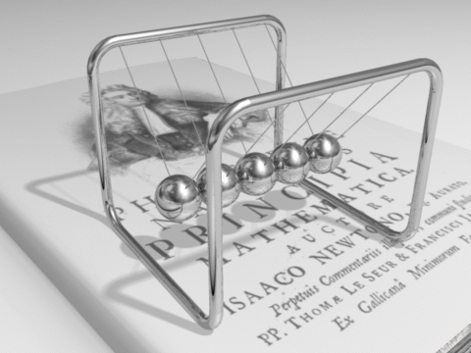

Slide 24
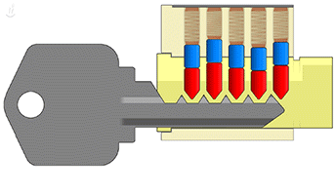
Bumping

Slide 25
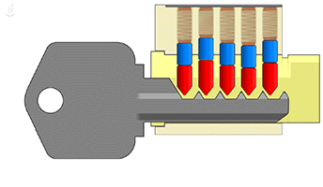
Bumping

Slide 26
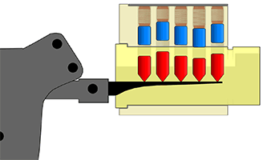
Snapping guns
http://toool.us/deviant/04-bumping/4.01-snapping_gun.gif

Slide 27
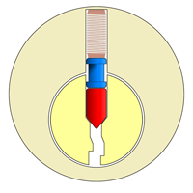
Lockpicking mitigations
Spool pins/driver

Slide 28
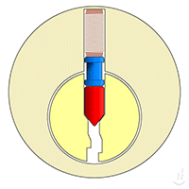
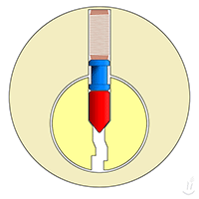
Spool pins/driver
How a spool pin affects lockpicking

Slide 29
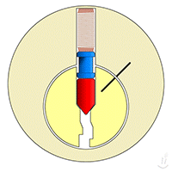
Defeating a spool pin
Takes finesse

Slide 30
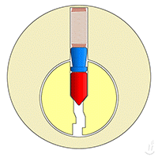
Lockpicking mitigations
Mushroom pin

Slide 31
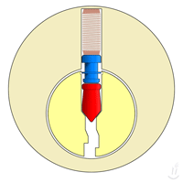
Lockpicking mitigations
Hybrid pin

Slide 32
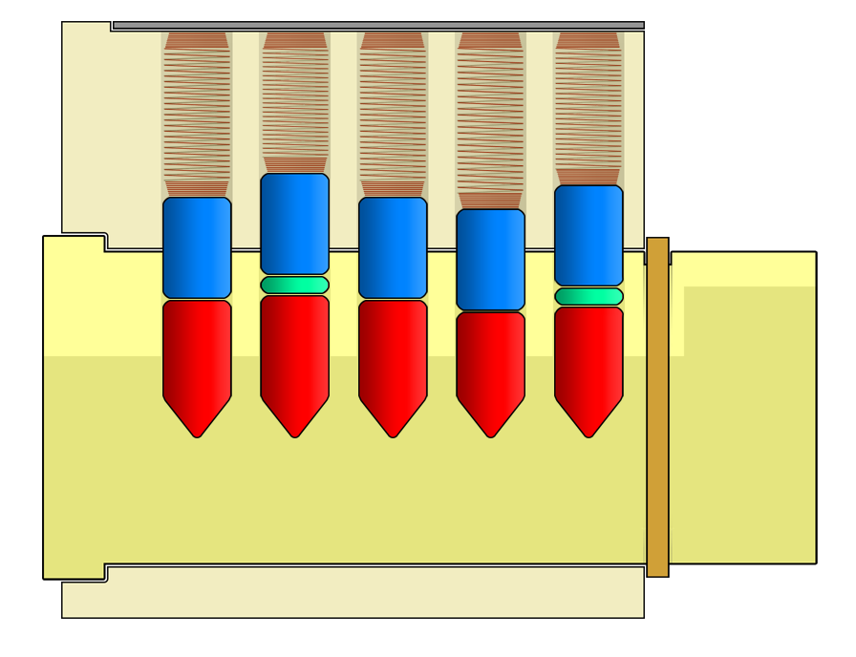

Slide 33
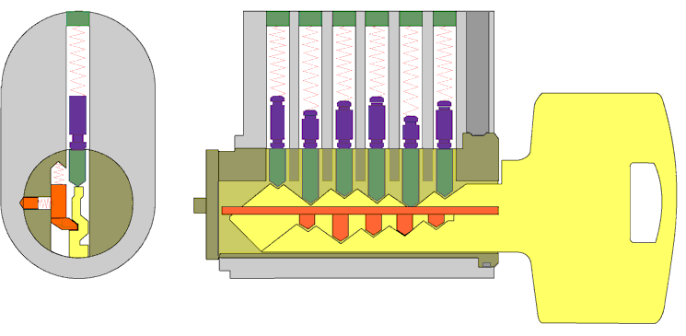
Lockpicking mitigations

Slide 34
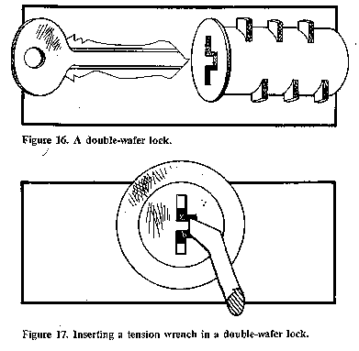
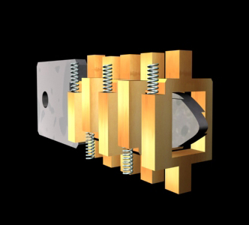
Other types of locks
Wafer Locks

Slide 35
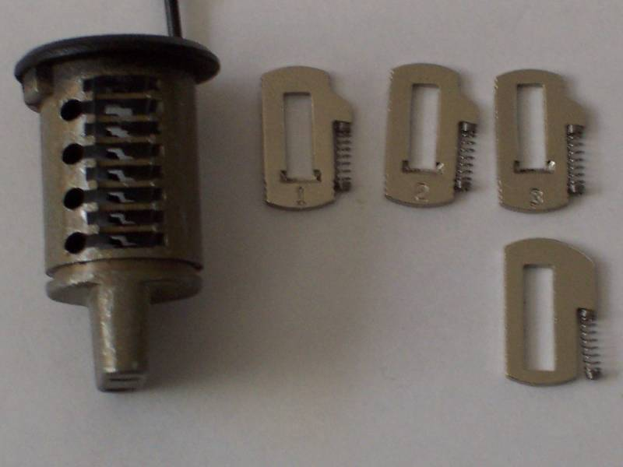
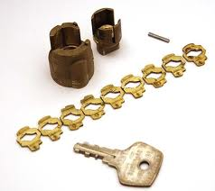
Wafer Lock

Slide 36
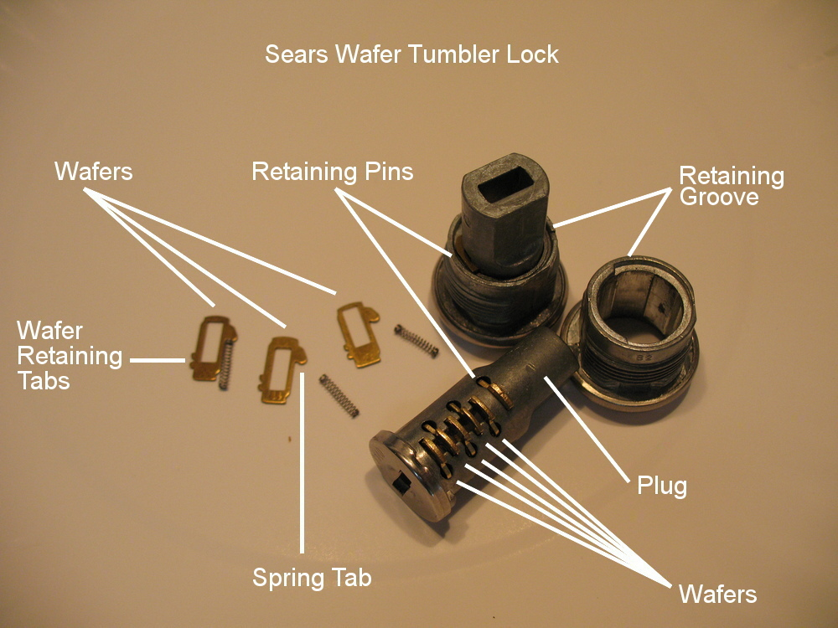

Slide 37
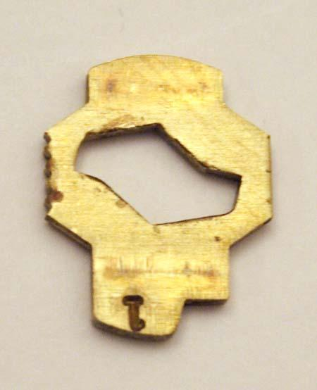
Wafers
can be easy to rake

Slide 38
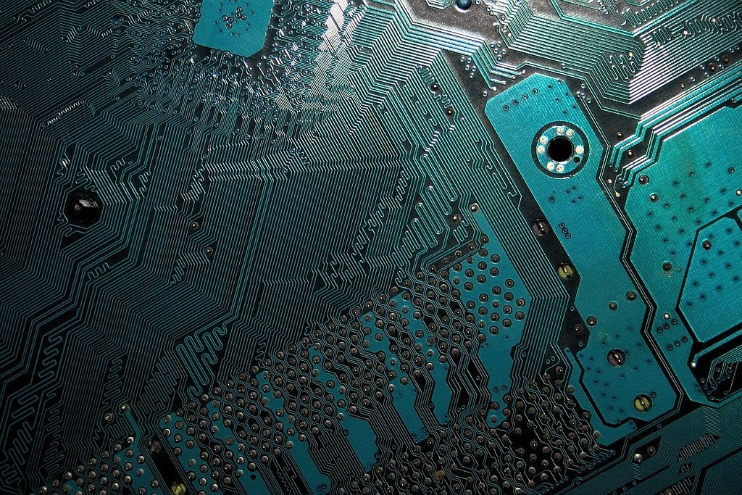
About Physical Access

Slide 39
Attackers can....
sabotage
steal (papers, hard drives, laptops, phones)
...
Related talk:
Steal Everything, Kill Everyone, Cause Total Financial Ruin: https://www.youtube.com/watch?v=JsVtHqICeKE

Slide 40
Below the Operating System
Much of the OS layer security is moot, if an attacker has physical access
Can reset:
BIOS password
OS passwords
Can physically take:
Hard Drives
External Storage
Can install
keyloggers
ethernet eavesdroppers
other malicious hardware/chips...

Slide 41
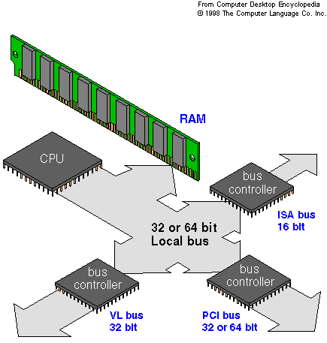
The Bus
The motherboard bus is the medium by which the CPU, RAM, HD, and other devices communicate.
peripherals
USB
...
IT IS A NETWORK!

Slide 42
The Bus
Is a broadcast network

Slide 43
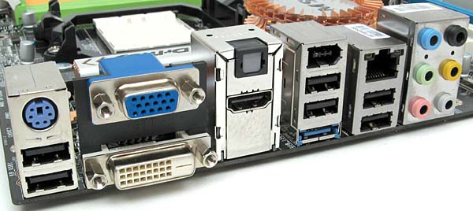
The Bus
What can access this network?

Slide 44
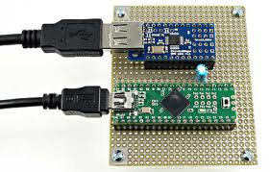
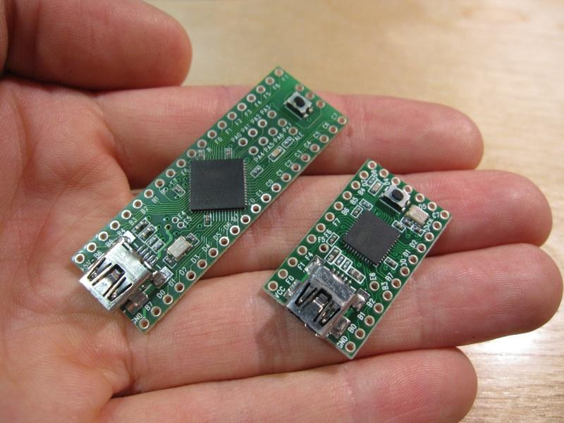
"custom" USB devices
http://www.youtube.com/watch?feature=player_embedded&v=Tbh1qrchyUo
http://www.pjrc.com/teensy/

Slide 45
Hacking over Powerlines
https://www.youtube.com/watch?v=XjBJHy1hD_A
https://www.youtube.com/watch?v=H_xTKZKPEmk
^ jammers / sniffers for home security systems
Can even send commands to the security system.

Slide 46
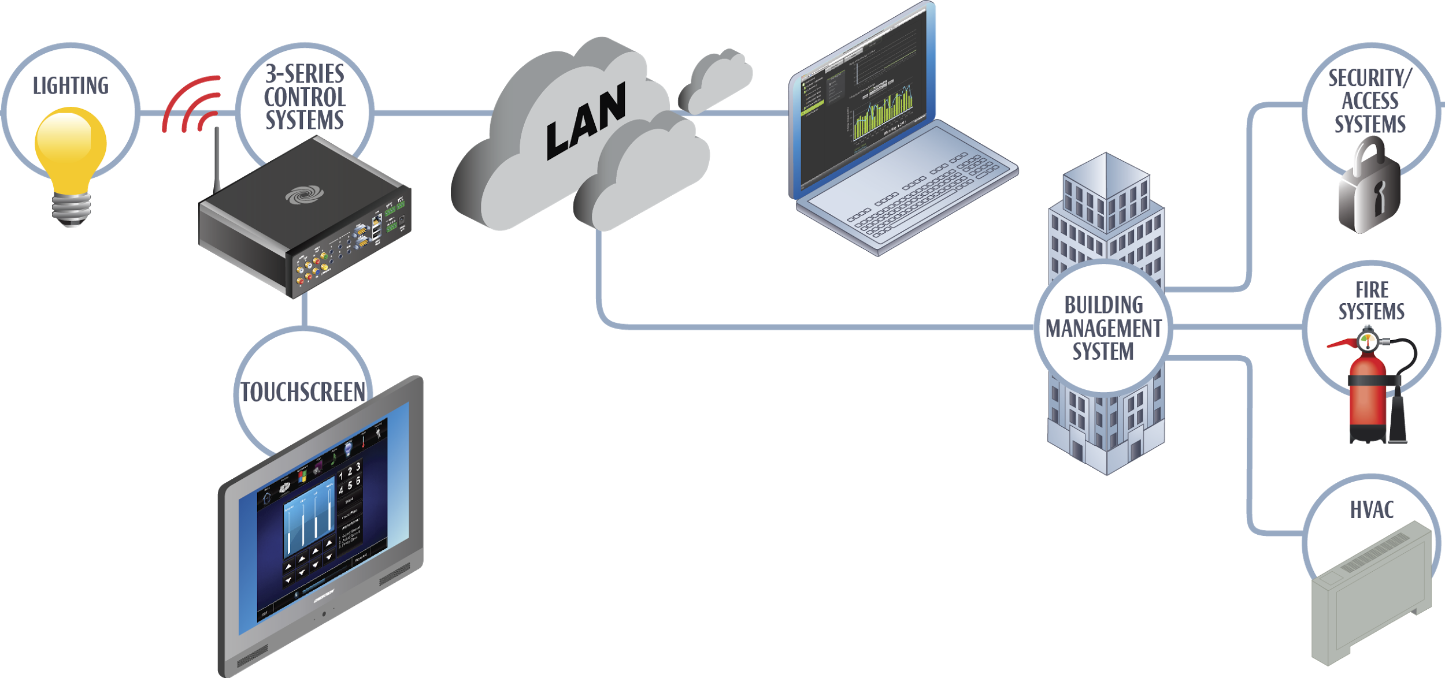
Hacking Buildings
https://www.youtube.com/watch?v=c4LMrKEO_t0

Slide 47
BacNET
Found in all areas of building automation:
Power / Water / HVAC / Metering
(distribution, sensory, control ...)
Fire Suppression
Smart Lights
Smart Elevators :D
Found in:
Factories, Plants
Office Buildings
(new) Residential

Slide 48
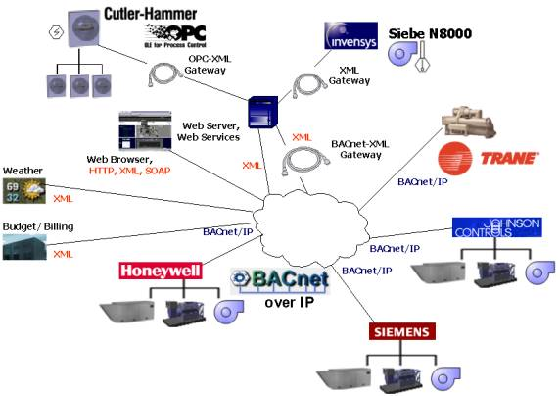
BacNET

Slide 49
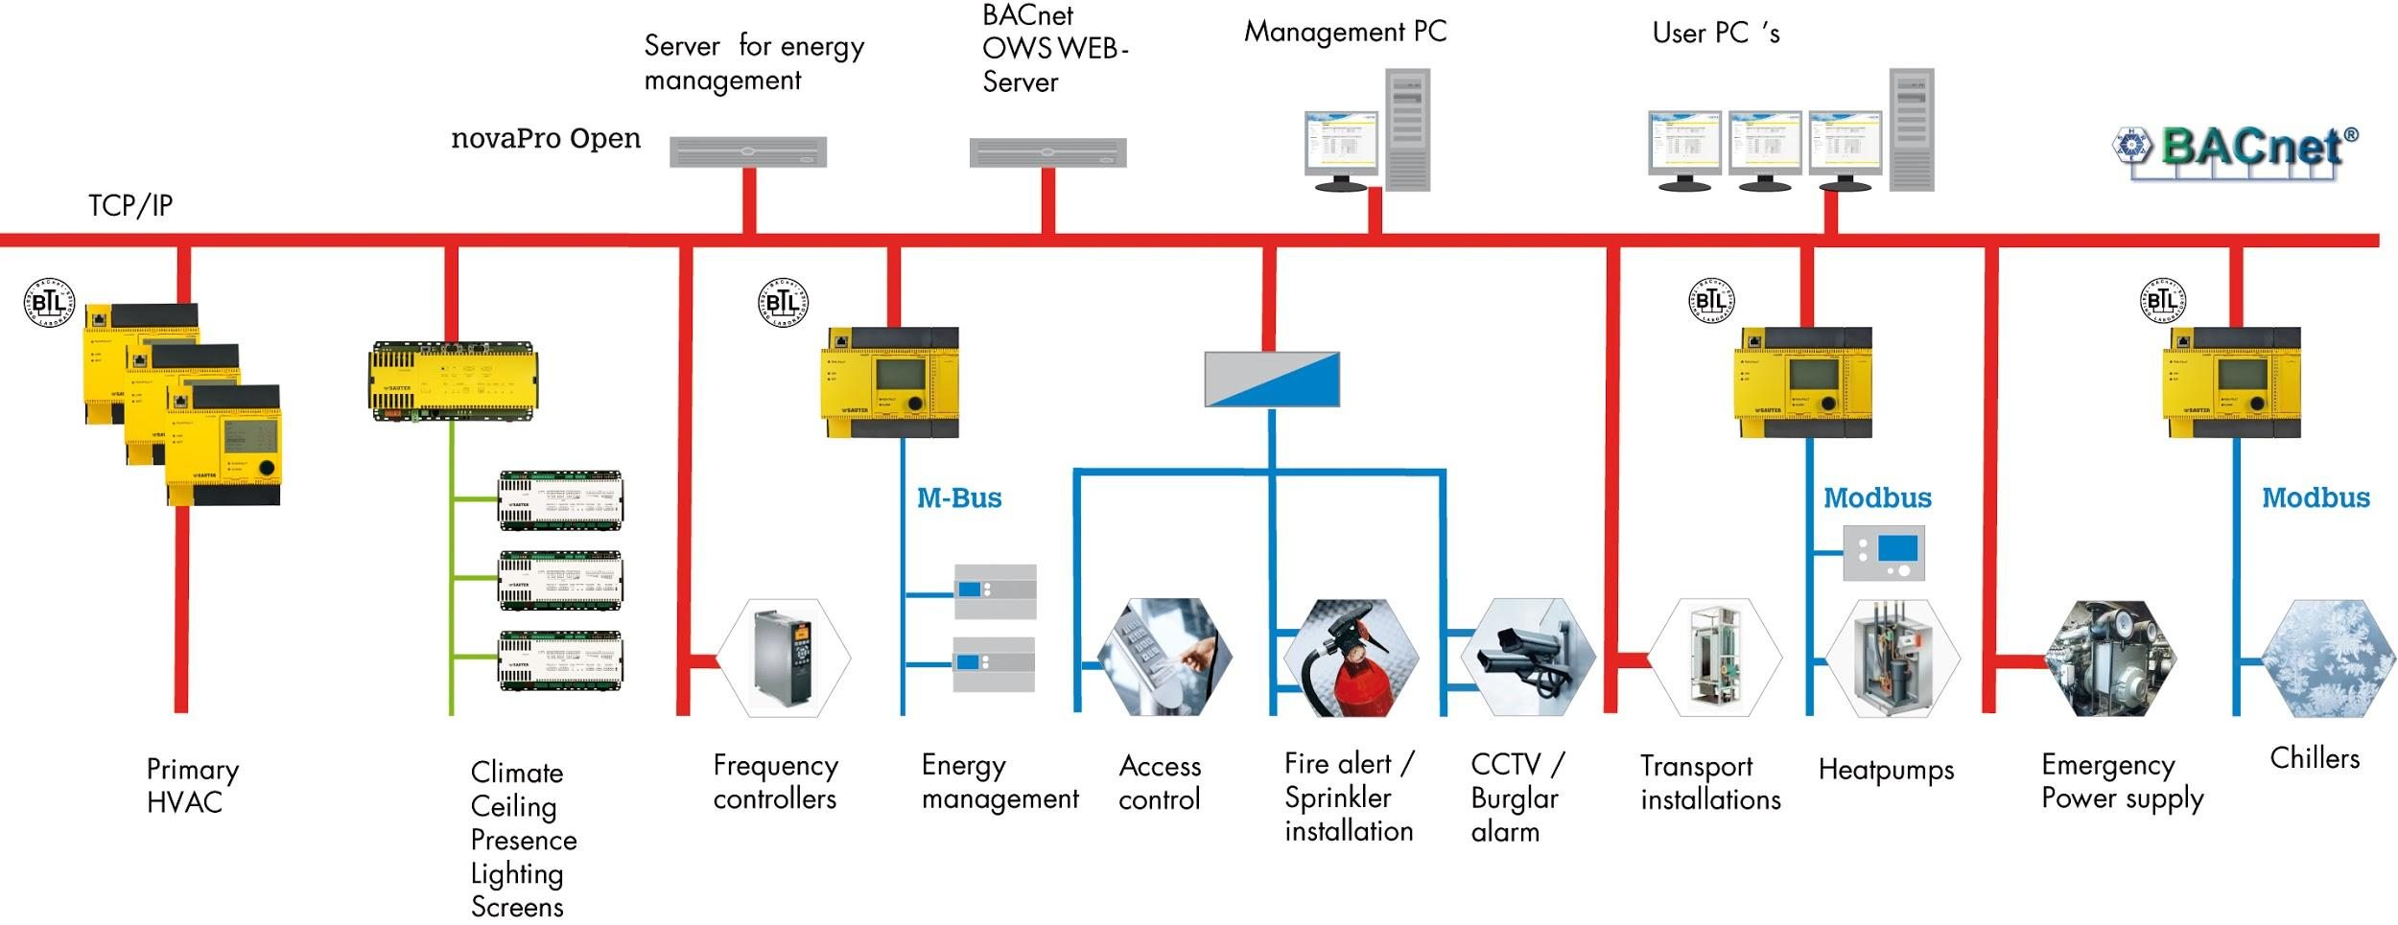
BacNET

Slide 50
Why should you care?
Chernobyl + 3 Mile Island - Man made disasters influenced by sensor readings
What if bad guys interrupt with your sensors?
BacNET has minimal session protection / security
BacNET packets are easy to spoof, no encryption, easy to intercept
Similar to IEC61850 standard for the Power Grid

